Slide 1
Fruit (Apple) Sales in USA Presentation
Presented by:
Noor E Kainat
Abdul Rehman Shaukat

Slide 2
Project analysis slide 3
Overview
MARKET ANALYSIS
TECHNICAL ANALYSIS
FINANCIAL ANALYSIS
ECONOMIC ANALYSIS
Vital Part of U.S. Agriculture Sector
Trend & Seasonality
In data
3.8% change in production
14% of the value of countries agricultural production
Increase in labor costs
Less land devoted to production
Increase in imports
.

Slide 3
Project analysis slide 2
Details of Data
Apple Sales in USA(Millions)
120 observations
Data
Data from United States Census Bureau
Contribution to economic growth
From Jan 2010-Dec 2019
Changes in production factors

Slide 4
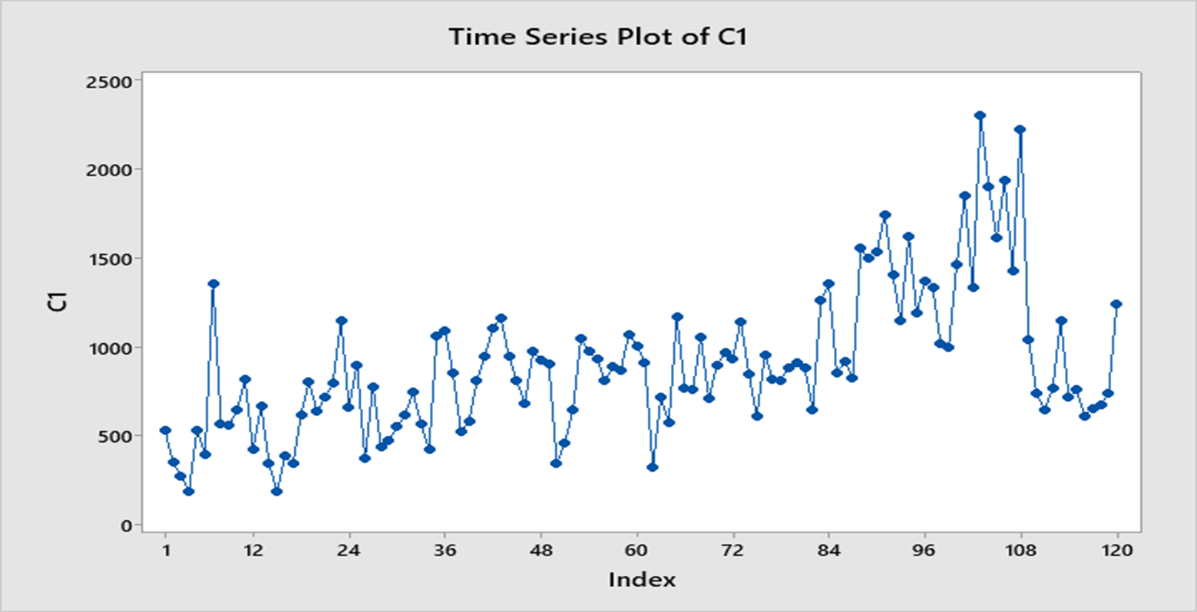
Project analysis slide 11
Time Series Plot for Apple Sales
Time series plot use d to visualize trends in counts or numerical values over time
Fluctuations in sales values
Increasing trend
Consumption as well as production affected causing increasing trend

Slide 5
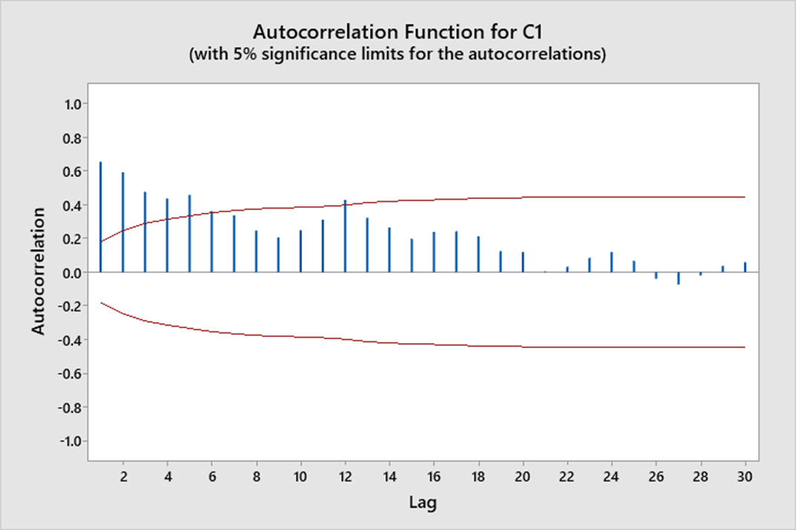
Project analysis slide 11
Auto Correlation for Apple Sales
Used to identify nature of data, pattern
Identify whether the data is stationary
Statistically significant at 5%
Time series, non stationary & seasonal pattern
Graph shows MA=5

Slide 6
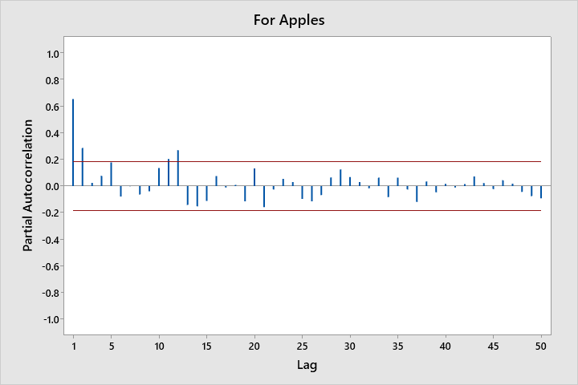
Project analysis slide 11
Partial Autocorrelation for Apple Sales

Slide 7
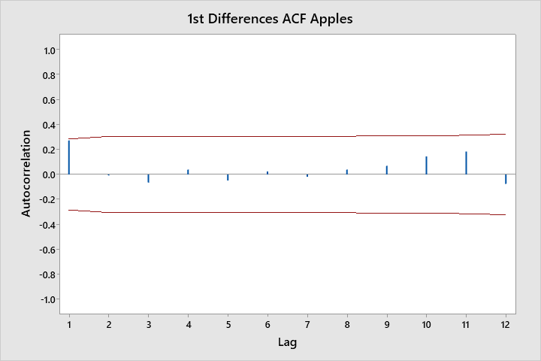
Project analysis slide 11
Auto Correlation for 1st Difference
Analyze the degree of similarity between a time series and a lagged version of itself.
Non stationary data set
AC of 1st Difference
1st difference taken to make data stationary

Slide 8
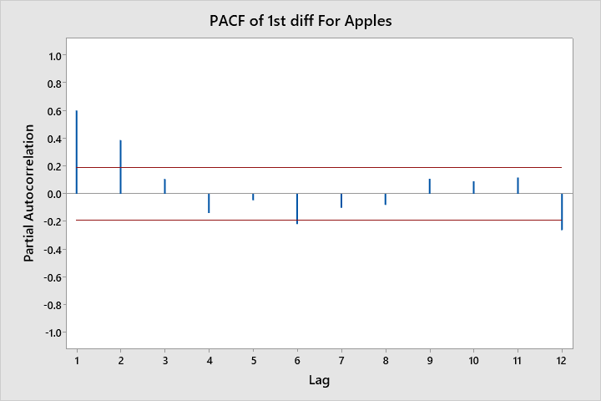
Project analysis slide 11
Partial Autocorrelation Function for 1st Differences
Graph graphically summarizes the strength of a relationship with an observation in a time series with observations at prior time steps.
PACF for Apple Sales in USA.
Graph shows AR=2

Slide 9
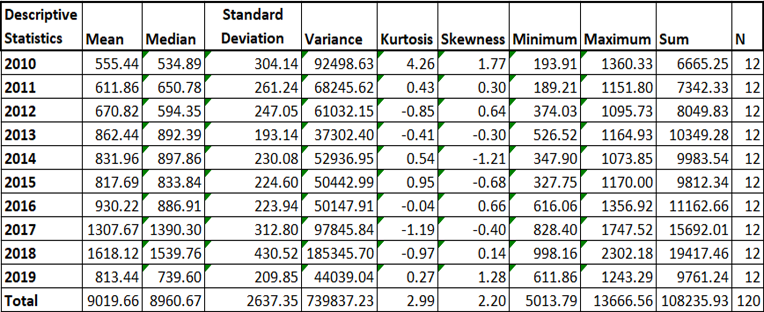
Project analysis slide 11
Descriptive Statistics

Slide 10
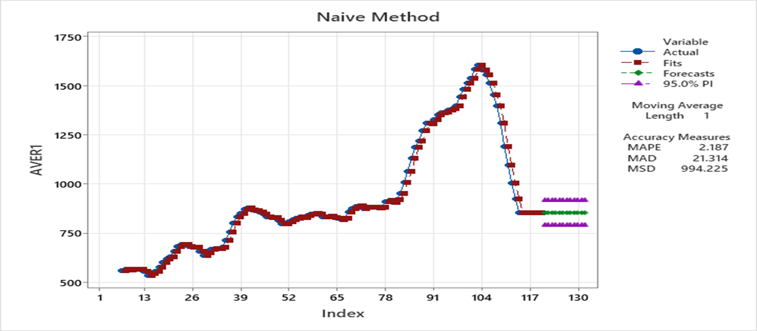
Project analysis slide 11
Naïve Method Plot for for Apples
Most weightage to most recent observations
Used on stationary data
MSD comparatively high
Not an adequate model

Slide 11
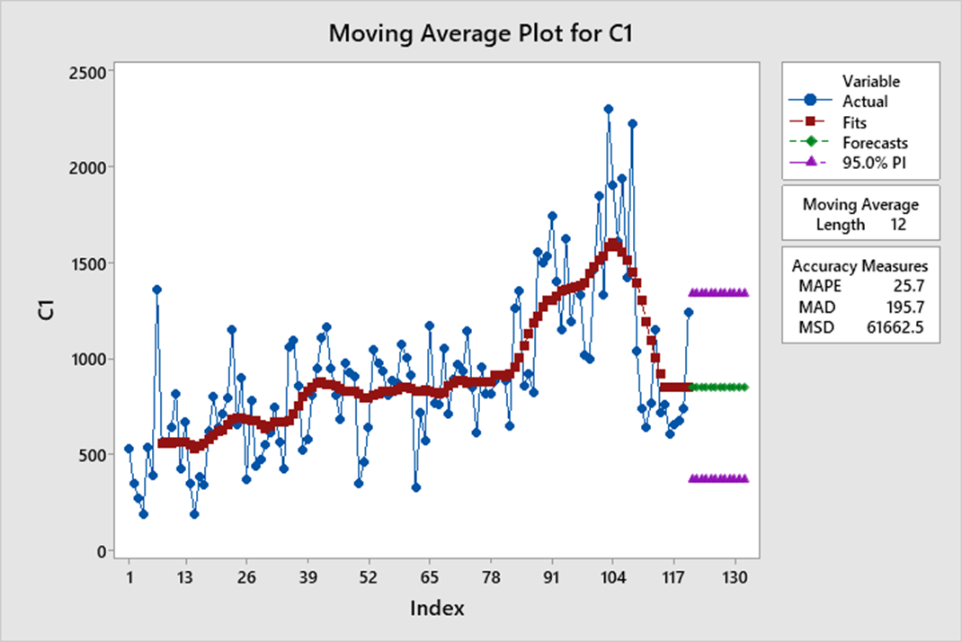
Project analysis slide 11
Moving Average for Apple Sales
Useful for forecasting long-term trends
Averages all previous forecasts
Smooths out the components of time series
MSD fairly high
Not an adequate model

Slide 12
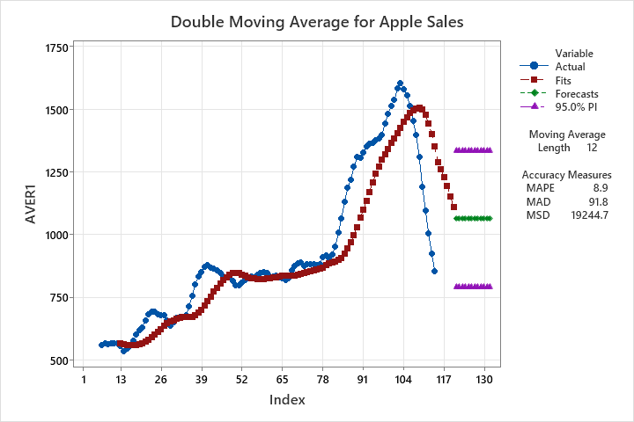
Project analysis slide 11
Double Moving Average for Apple Sales
Method mostly adequate for trend with data but no seasonality
Smooths out past data
MSD fairly high, less than Moving average
Not an adequate model

Slide 13
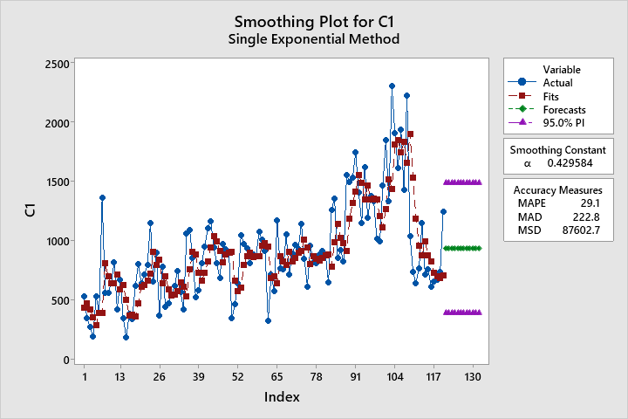
Project analysis slide 11
Single Exponential for Apple Sales
Exponential smoothing is used for time-series data with no seasonality or trend
Requires a single smoothing parameter that controls the rate of influence from historical observations
MSD fairly high, more than Moving average method
Not an adequate model

Slide 14
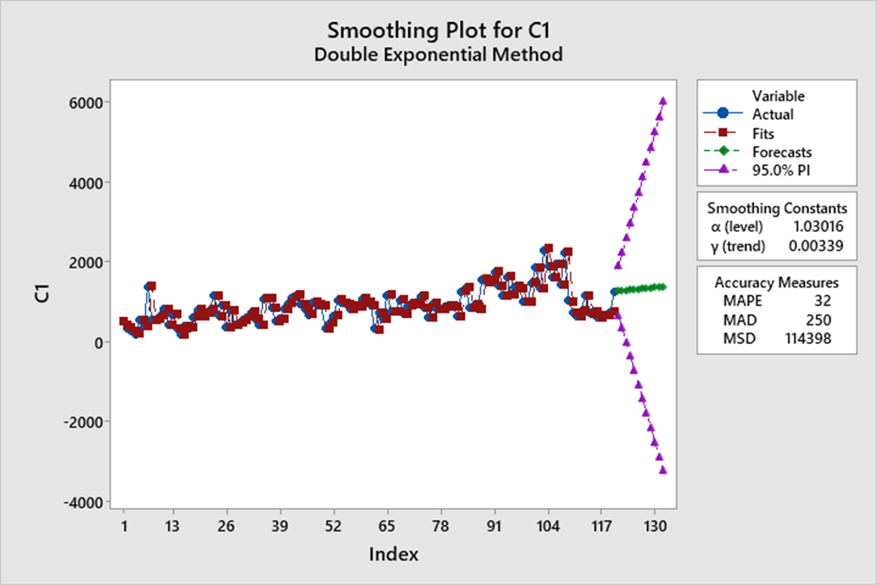
Project analysis slide 11
Double Exponential for Apple Sales
This method models dynamic gradients because it updates the trend component for each observation.
MSD fairly high, more than Single exponential method
Not an adequate model

Slide 15
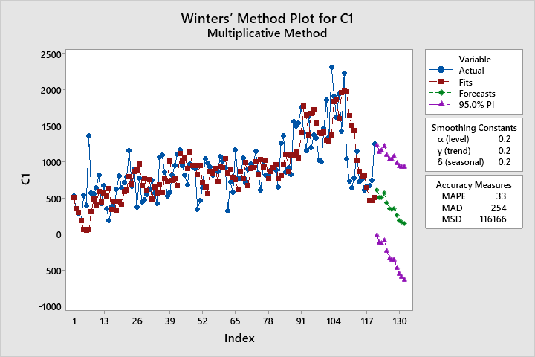
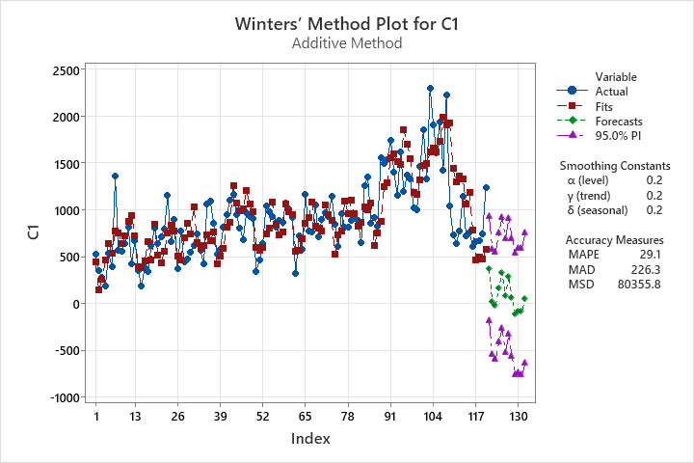
Project analysis slide 11
Winters Method(Multiplicative & Additive) for Apple Sales
Winters method: A way to model three aspects of the time series: a typical value (average), a slope (trend) over time, and a cyclical repeating pattern (seasonality).
Allows us to include seasonality while making the prediction along with the trend.
MSD fairly high
Not an adequate model

Slide 16
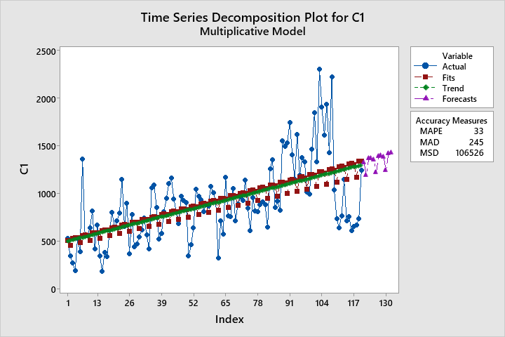
Project analysis slide 11
Decomposition with Multiplicative Model for Apple Sales
Fitted Trend Equation
Yt = 498.4 + 6.732×t

Slide 17
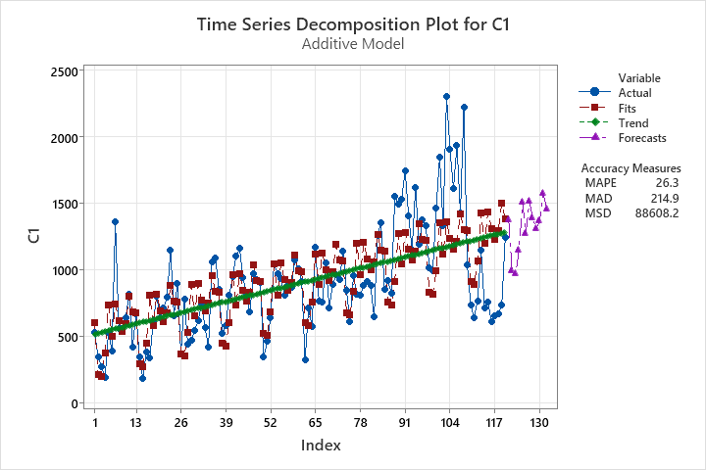
Project analysis slide 11
Decomposition with Additive Model for Apple Sales
Fitted Trend Equation
Yt = 513.3 + 6.424×t

Slide 18
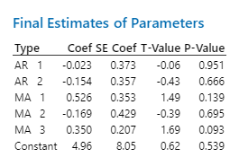
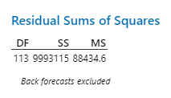

Project analysis slide 11
ARIMA
ARIMA (2,1,3)
Equation
$${\hat{Y}}_{t+1}= {\hat{∅}}_{1}Y_{t}+{\hat{∅}}_{2}Y_{t−1}+ {\hat{θ}}_{1}t+ {\hat{θ}}_{2}{\hat{ε}}_{t−1}+ \hat{δ}$$
$${\hat{Y}}_{t+1}=−.023Y_{t}−.154Y_{t−1}+ .526t−.169{\hat{ε}}_{t−1}+{.350\hat{ε}}_{t−2}+ 4.96$$

Slide 19
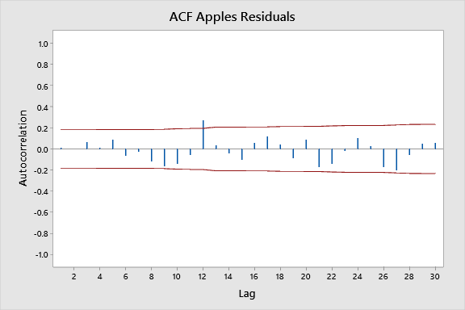
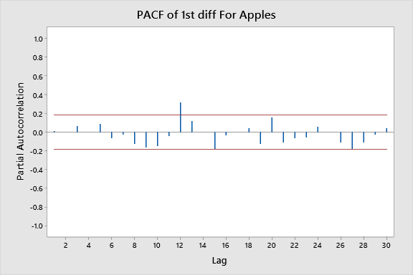

Slide 20
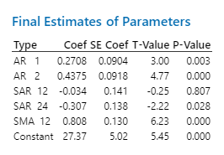
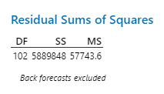
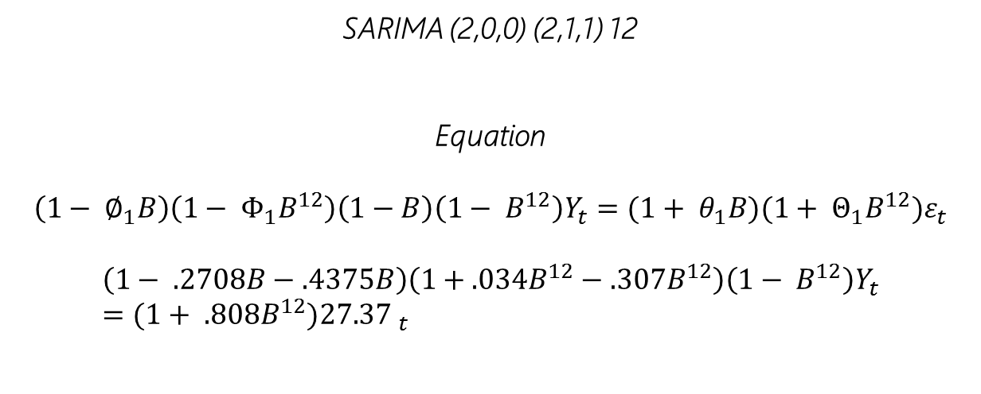
Project analysis slide 11
SARIMA
SARIMA (2,0,0) (2,1,1) 12
Equation
$$\left(1− ∅_{1}B\right)\left(1− Φ_{1}B^{12}\right)\left(1−B\right)\left(1− B^{12}\right)Y_{t}=(1+ θ_{1}B)(1+ Θ_{1}B^{12})ε_{t}$$
$$\left(1− .2708B−.4375B\right)\left(1+.034B^{12}−.307B^{12}\right)\left(1− B^{12}\right)Y_{t}=(1+ .808B^{12}){27.37 }_{t}$$

Slide 21
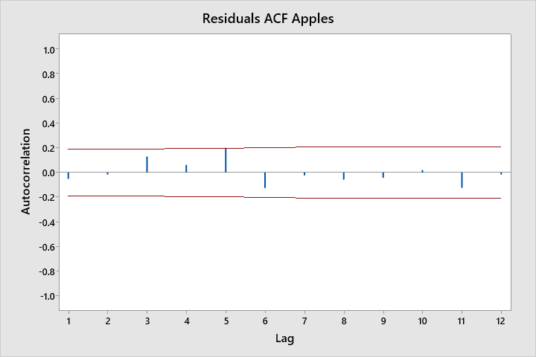
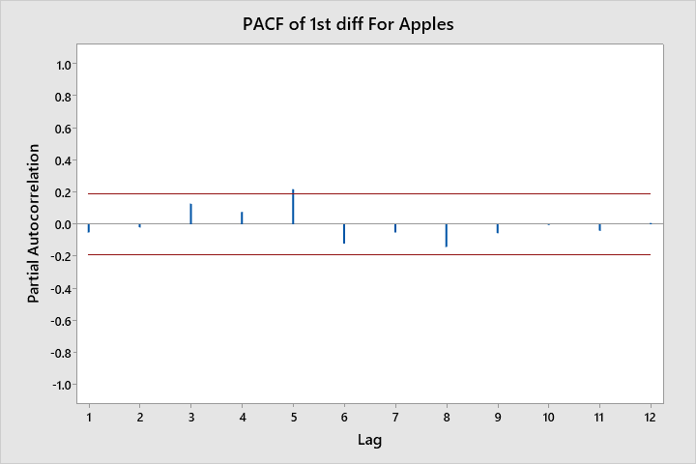

Slide 22
Project analysis slide 11
Evaluation Criteria
Naïve Method: 994.225
Moving Average: 61662.5
Single Exponential Smoothing: 870620.7
Holts Method: 114398
Winters Method (Additive): 80355.8 (Multiplicative): 116166
Seasonal Decomposition (Additive): 88608.2 (Multiplicative): 106526
ARIMA: 57743.6
SARIMA: 88434.6

Slide 23
Project analysis slide 6
Conclusion
.
Naïve method smallest MSD, choose it over other methods .
Monthly data 2010-2019.
Graphs & Models shown
Various time series forecasting models applied.
.
.

Slide 24


